Slide 1
Kubernetes Upgrades: Less Pain, More Gain
(and Maybe a Little Swearing)
Jago Macleod, Google
jagosan

Slide 2
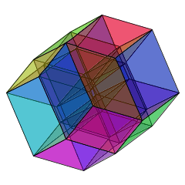
The Challenge
OS
Container Runtime
Features
# Clusters
Coordinated upgrades across multiple independently-versioned components is a defining challenge of our time
CVEs
Networking stack
# Everythings
# of Nodes
Complexity is increasing in every dimension, at every layer in the stack.
Pod Churn
Counter-intuitively, slowing down is counterproductive.
Source of hypercube image: http://www.gregegan.net/APPLETS/29/29.html

Slide 3

No “Haunted Graveyards”
Notes:
We have a core value at google, the idea that there should be no haunted graveyards.
The scarier something is, the more you avoid it. And the more you avoid it, the more the ghosts and ghouls come out.

Slide 4

Transitive Dependencies

Slide 5
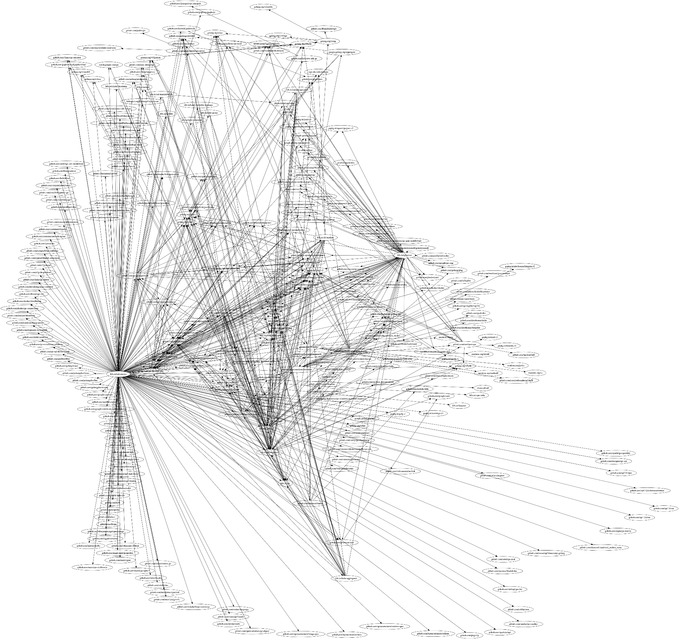
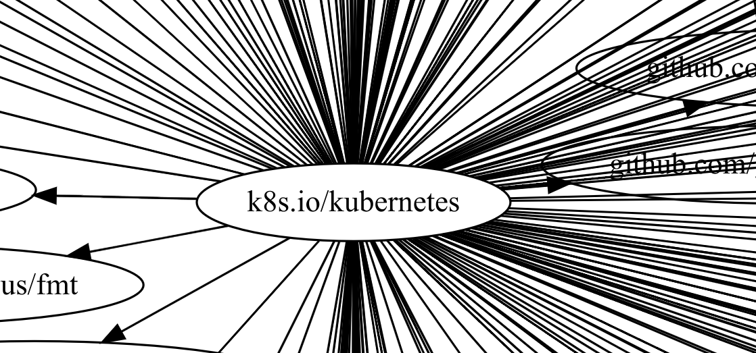
Kuberntes

Slide 6
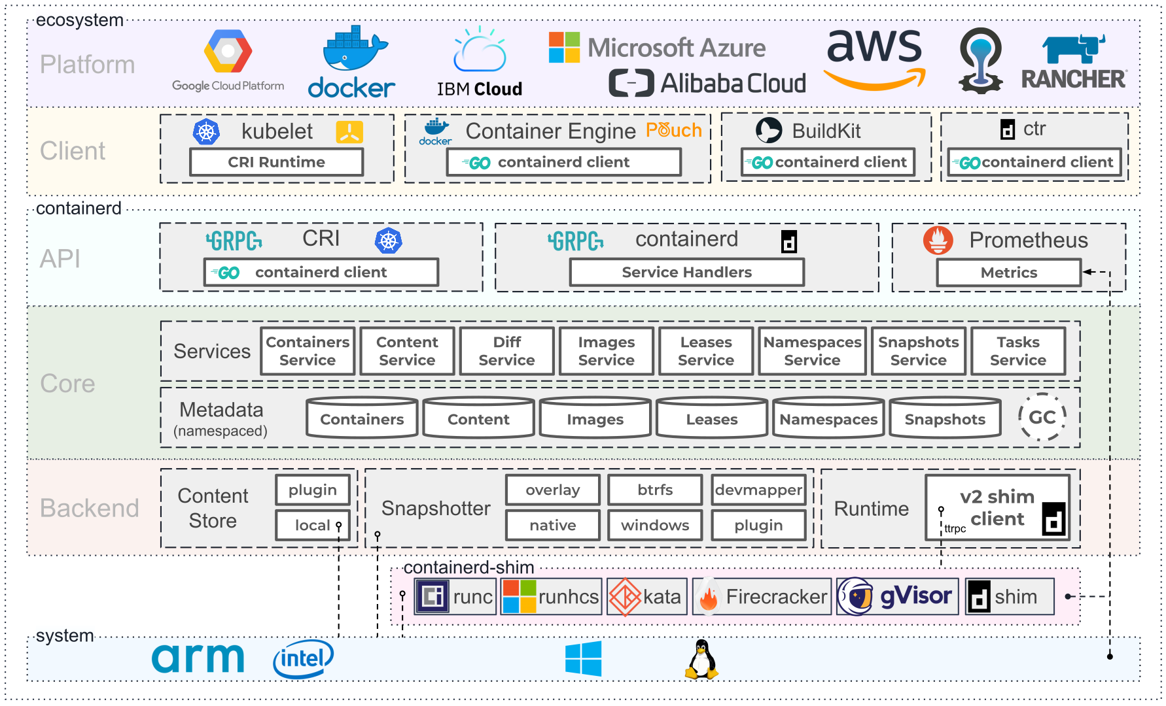
Notes:
Source: https://containerd.io/

Slide 7
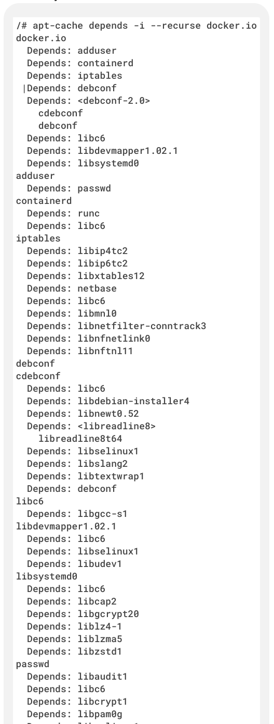
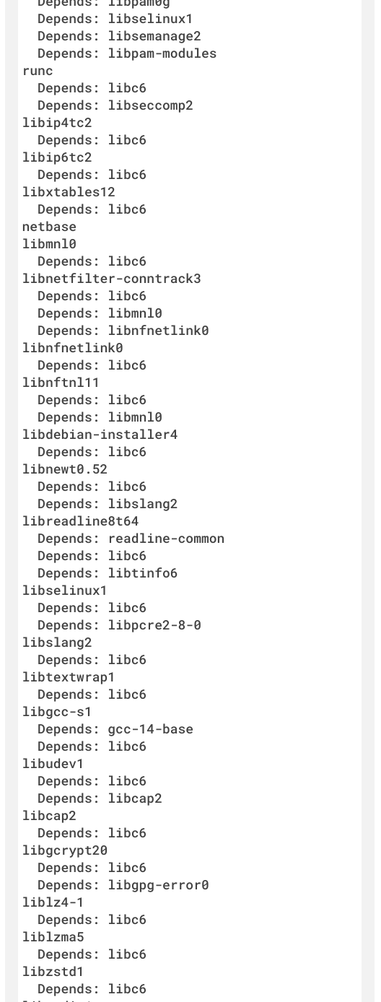
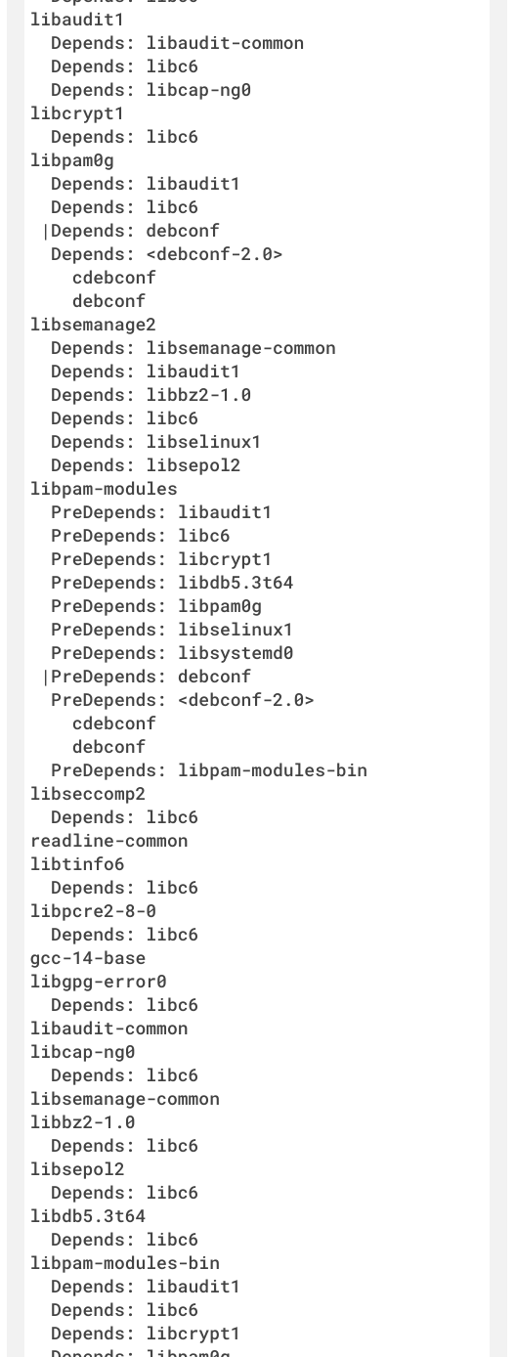

Dependencies:
Operating System

Slide 8
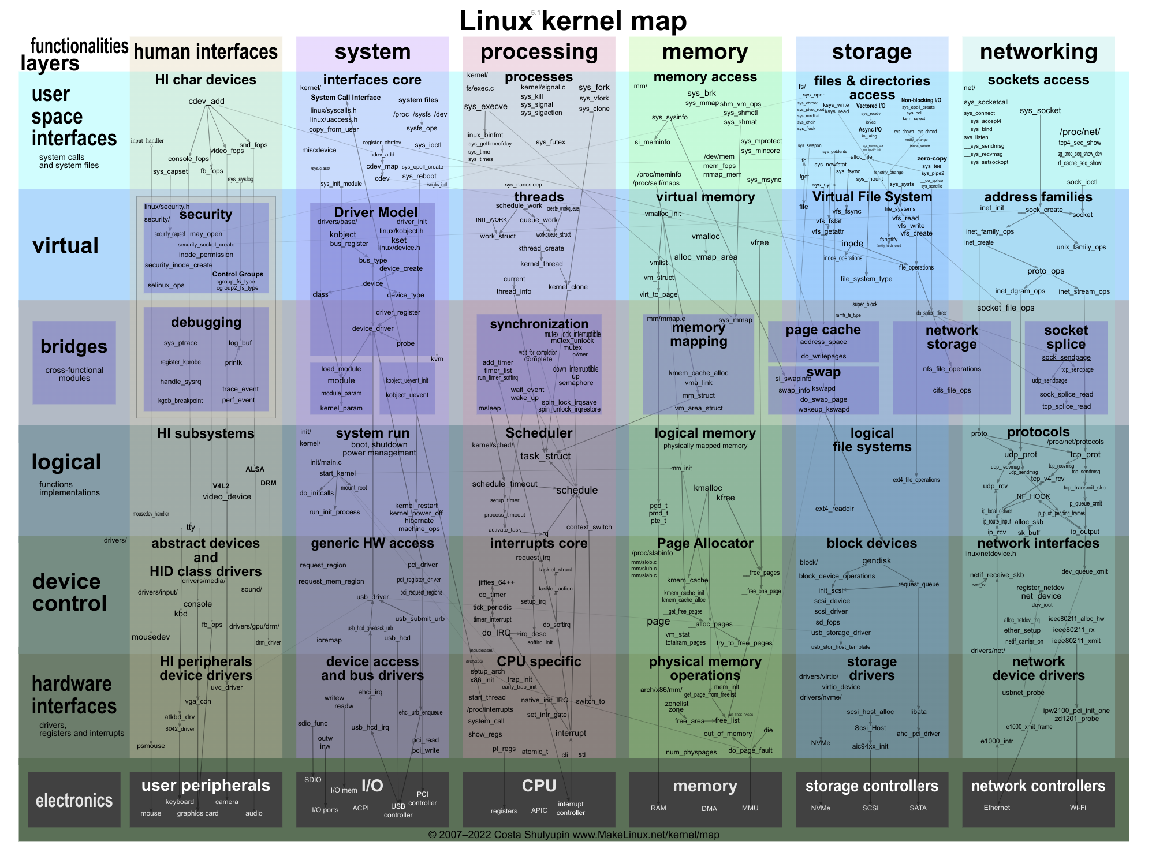
Oh yeah…
… the linux kernel!

Slide 9
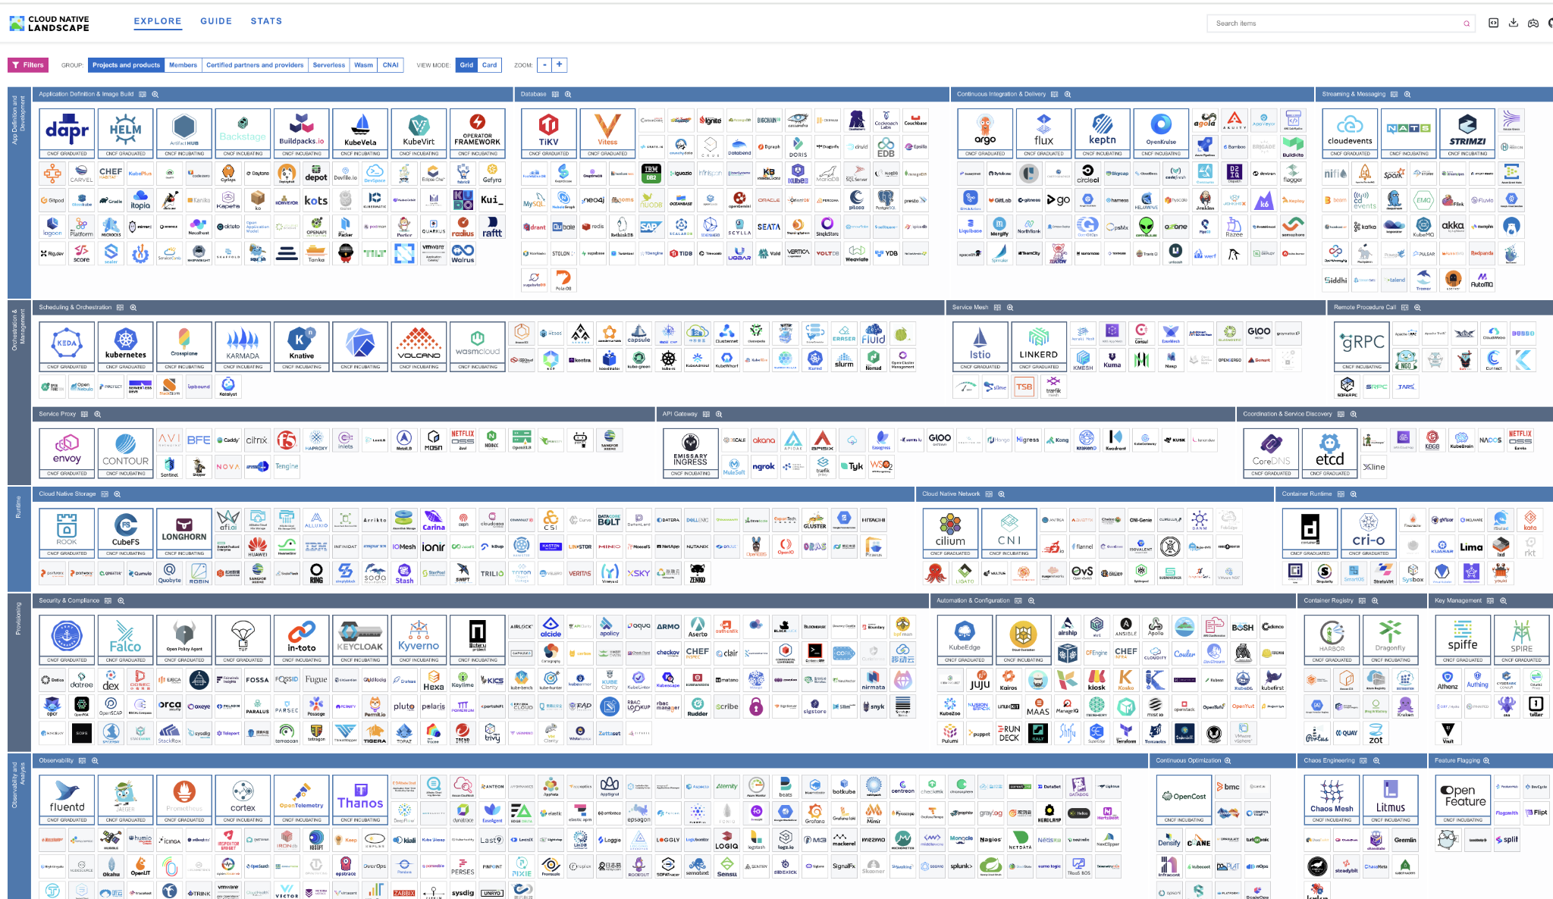
And…

Slide 10
That looks hard - what if we just, you know, didn’t?
Many managed Kubernetes services offer Extended / LTS options.
While these can be a critical short-term convenience, they are not a long-term solution.
LTS affords a one-time reprieve of 4 or 8 months…
followed by the exact same pace of required upgrades (every 4 months)....
but on a strictly riskier combination of versioned components.

Slide 11
A few reasons to upgrade
1. Security: reported security vulnerabilities are accelerating over time, and as kubernetes becomes more popular, there is more focus on it as an entry point
2. Stability: there are many single-version controllers and managed services which update to run on newer versions of kubernetes; even when they claim to be compatible with older versions, they are rarely tested against older versions
3. MTTR: the mean time to resolution for incidents that involve older versions is higher than mttr for incidents in newer versions; the edge cases found later in the lifecycle are challenging, the dependencies may no longer be maintained, and the developers have to remember how the technology worked back then
4. Risk: staying on older versions means risk accumulates over time; as bug fixes and security patches are applied to newer versions, the risk accumulation accelerates over time, making it increasingly challenging to upgrade to a modern version. And just like finances, compounding interest can create an insurmountable challenge which requires a wholesale migration

Slide 12
A few more reasons to upgrade
5. Complexity reduction: maintainers are on an absolute mission to reduce complexity and eliminate tech debt and dependencies in Kubernetes. In 1.31 this year, 1.5M lines of cloud provider code was removed, the biggest reduction in code in K8s history. Etcd is about to remove XX dependencies in the k/k. Newer versions are often less complex.
6. Expertise: by upgrading frequently, you gain an understanding of how your system works, which metrics matter and which are less important. You *will* have to upgrade quickly at some point, and it is essential to gain operational expertise. (Please, make sure there are at least 3 people with this knowledge!)
7. Features: yes, features are the very last reason to upgrade Kubernetes. Even if you /think/ you desperately need a brand new feature, someone, somewhere, found a workaround that is perhaps less elegant or less efficient, but will work until the feature is available. (So please don't put pressure on your provider to backport features!)

Slide 13
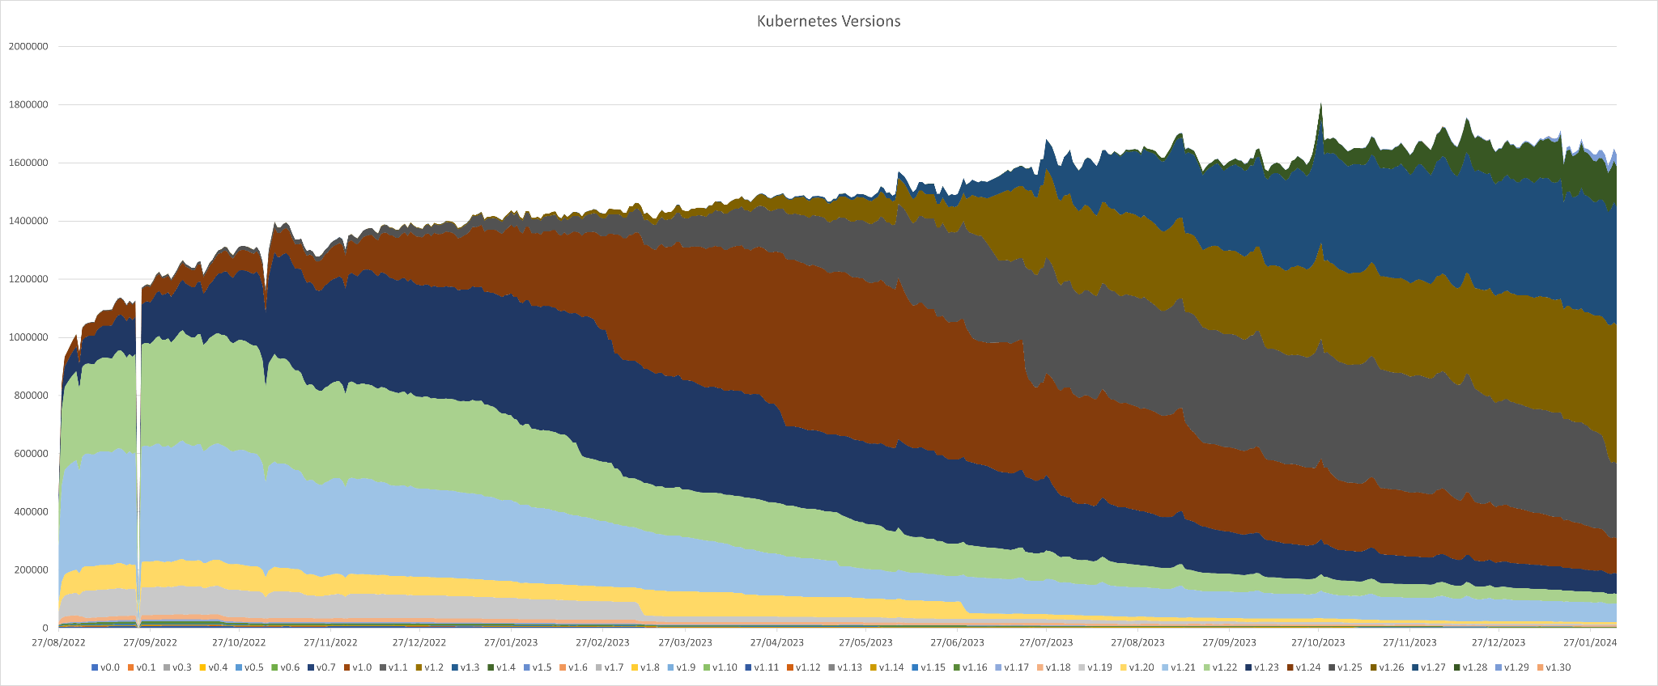
Kubernetes From Feb 2024
1.23
1.22
1.21
Notes:
https://raesene.github.io/blog/2024/02/17/a-final-kubernetes-censys/
Should be taken as directional but perhaps not representative of global penetration.
Breakdown of the 1.6+ million Kubernetes clusters that reveal their version numbers on the Internet (i.e. exposing their /version without authentication)
And LTS / Extended Channel exacerbates this challenge

Slide 14
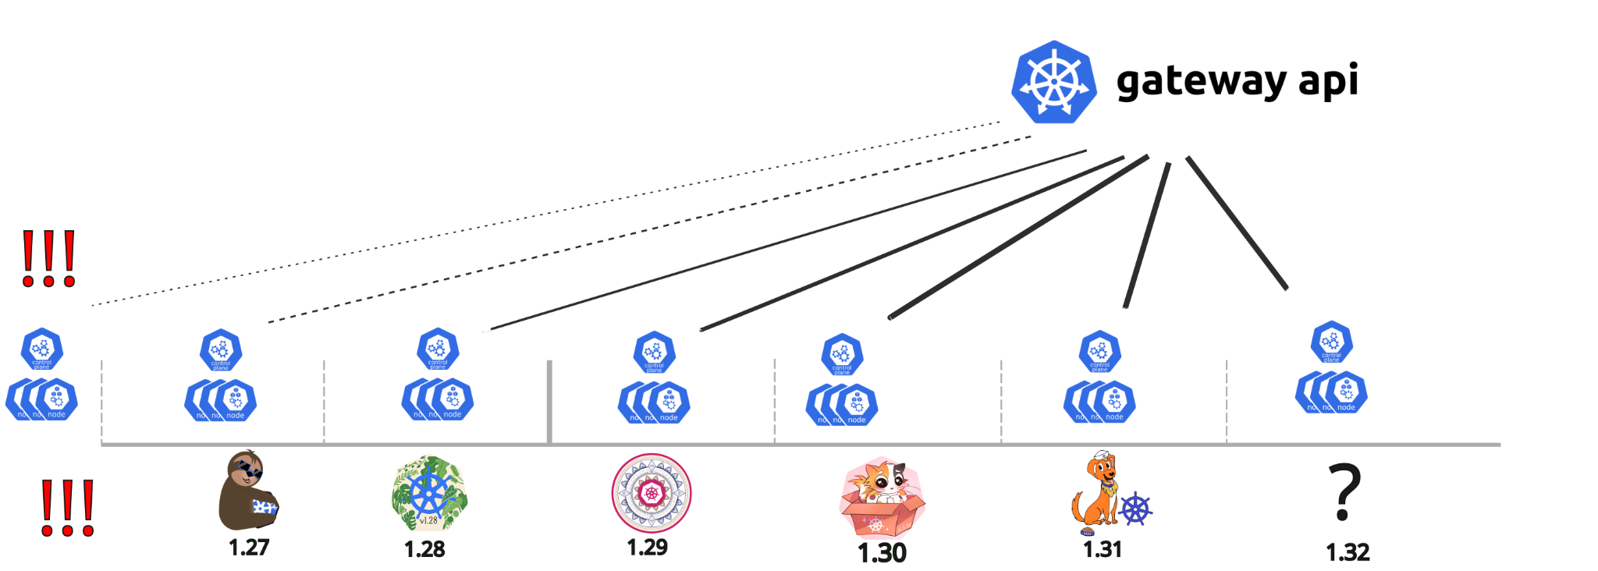
Ecosystem implications of longer support

Slide 15
Ugh, ok fine. So…. what to do?
Working hard on:
Backward compatibility and upgrade reliability
Including ability to roll back (gasp!)
Version emulation / compatibility mode
The same binary can serve multiple API versions
Tech debt reduction in every dimension

Slide 16
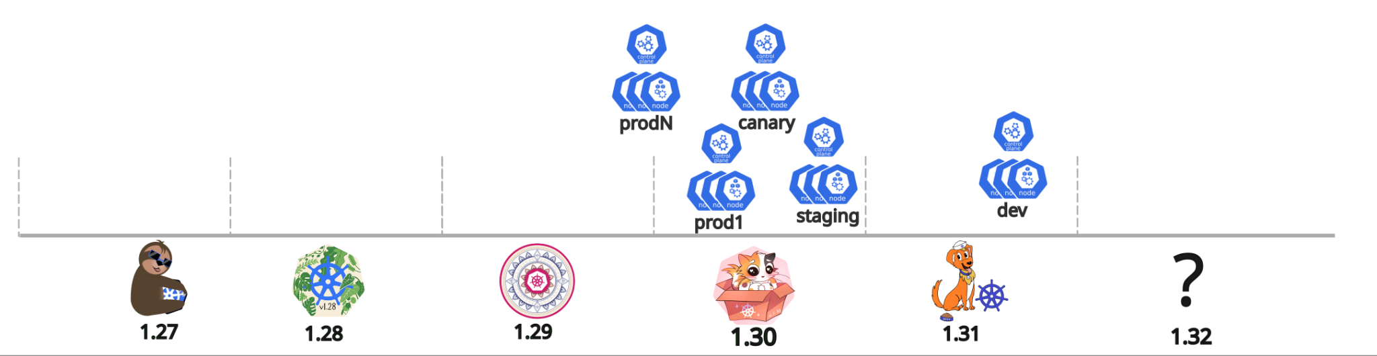
Risk tolerance across cluster portfolio

Slide 17
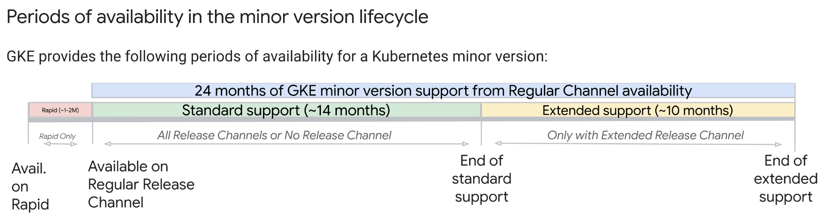
Time

Slide 18
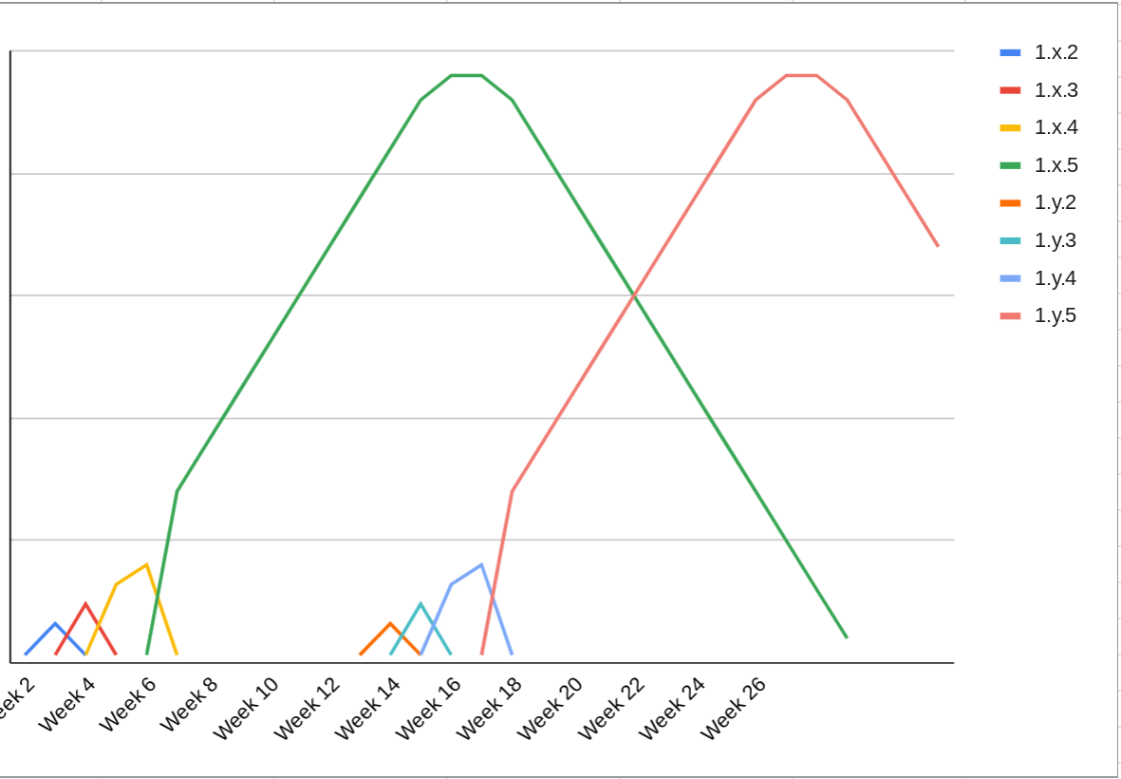
GKE Minor Release Adoption - Idealized
New versions introduced into Rapid Channel First
Versions that accumulate enough soak time in cluster days & meet SLOs are promoted:
To GA & available in Regular Channel
To default & upgrade target
To Stable Channel
# Clusters
Time
Notes:
jago
In the ideal model, a minor release of Kubernetes becomes available every 3 months; a few patch releases later, it’s ready for prime time and customers upgrade.
This graph shows an idealized view of GKE versions accumulating soak time, getting a bug fix / new patch release, and several release candidates later, one is promoted.
In this ideal model, a user could conceivably upgrade once every 3 months, from stable minor release to stable minor release. A couple of clusters, a few times a year - that’s conceivable to manage manually.

Slide 19
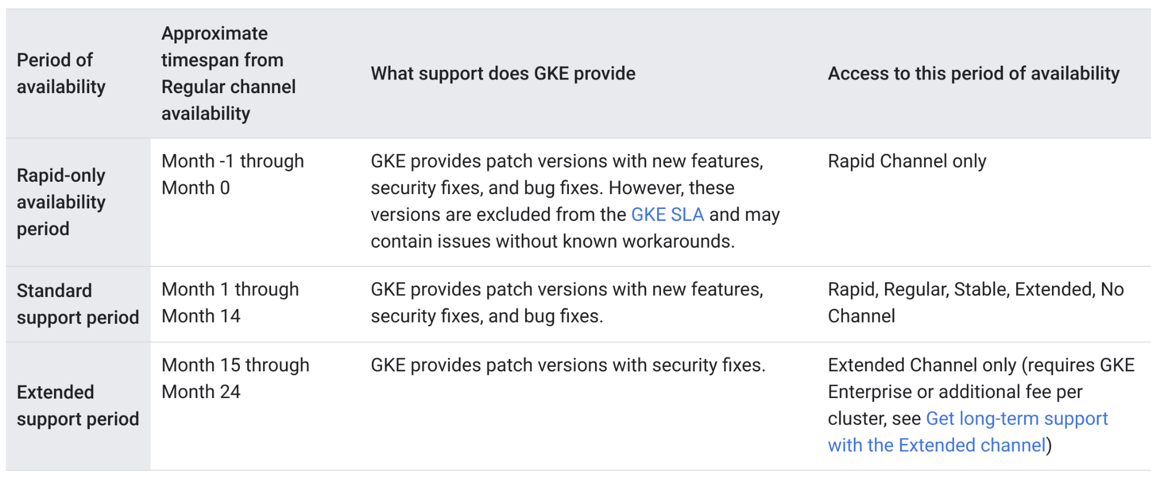

Slide 20
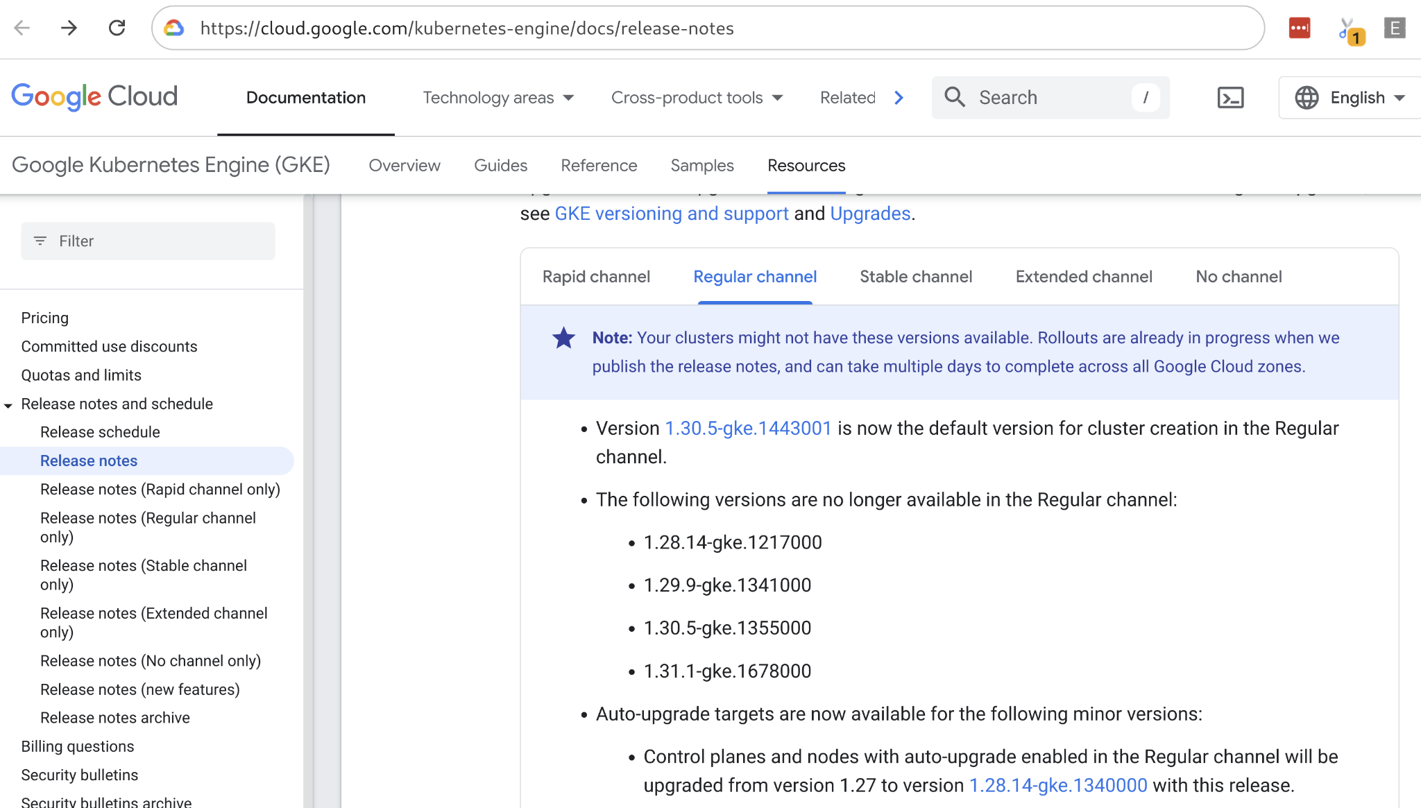
https://cloud.google.com/feeds/gke-main-release-notes.xml

Slide 21
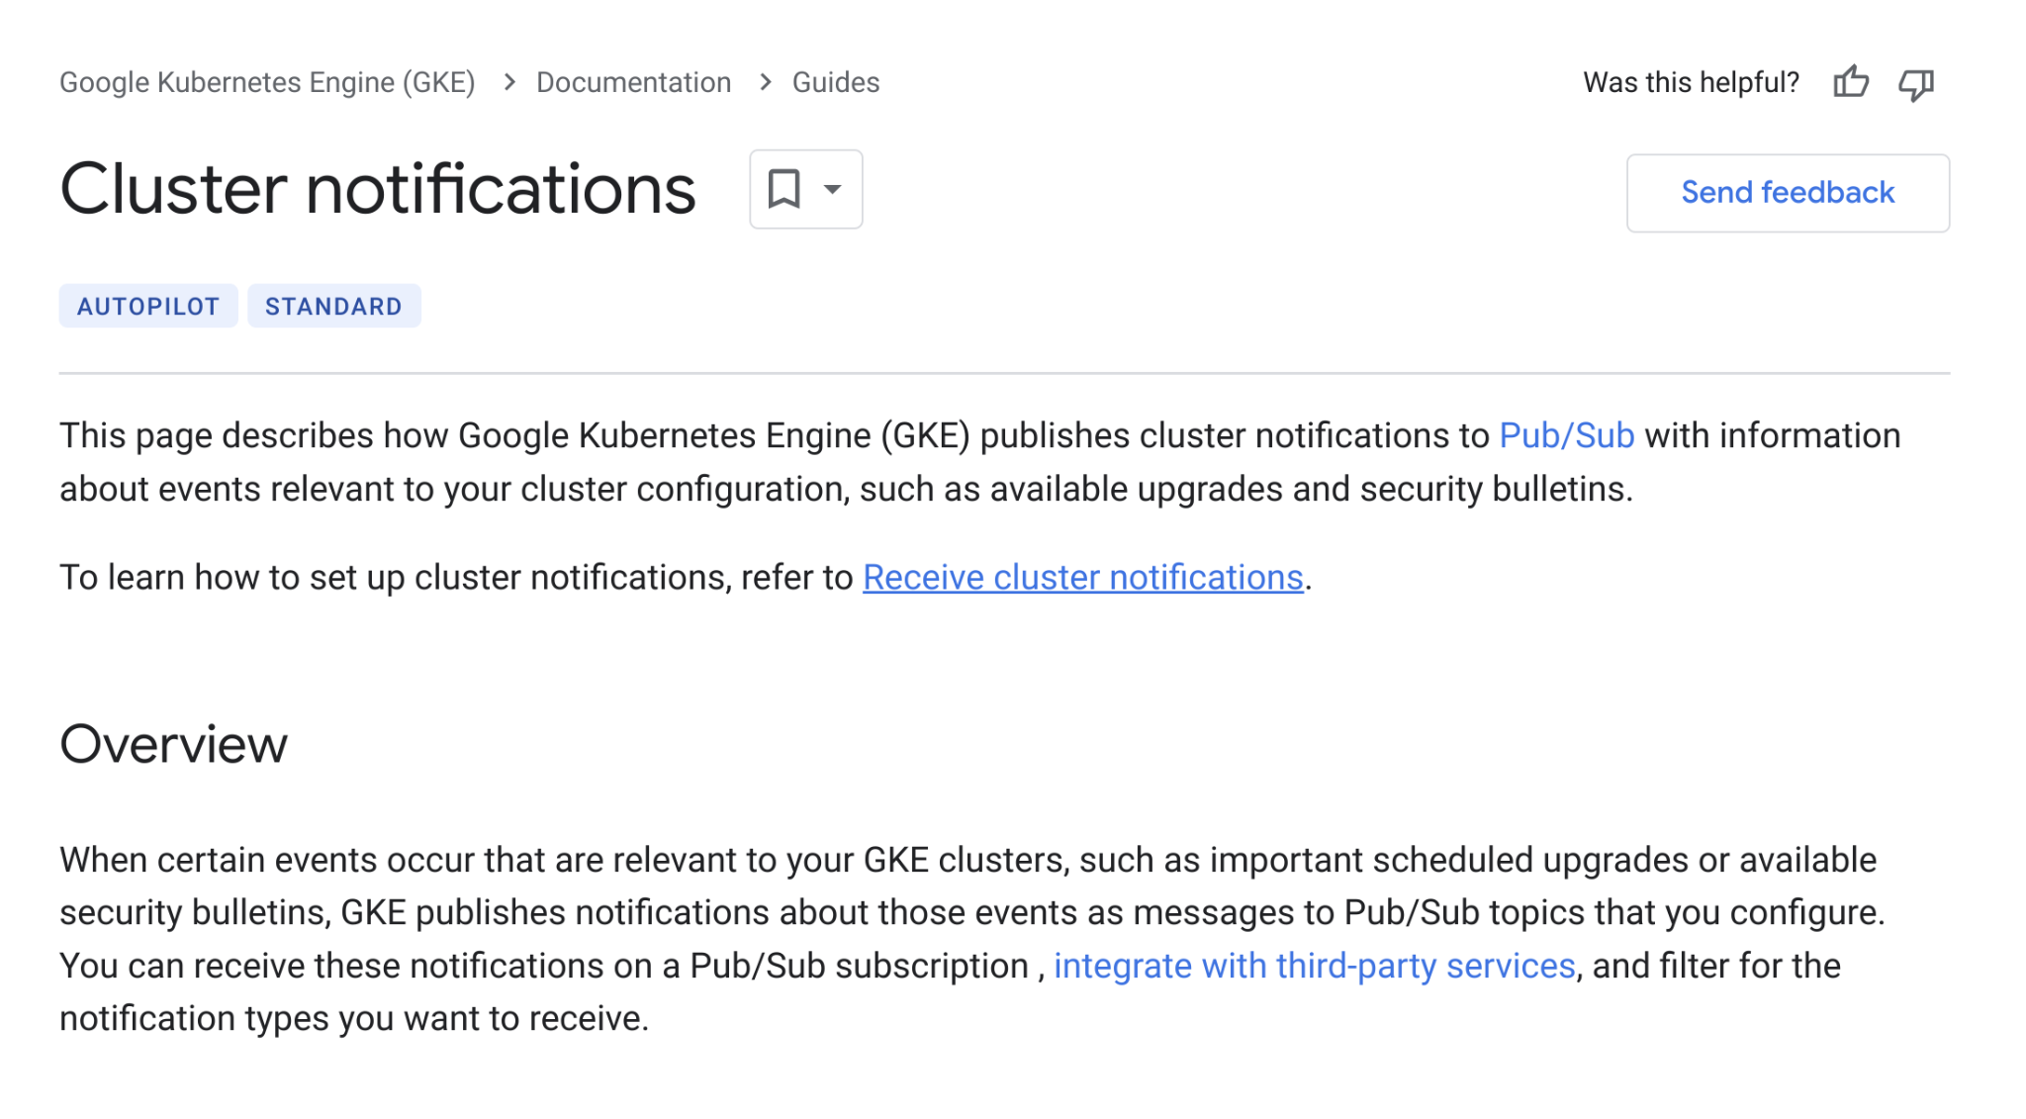
Monitor everything

Slide 22
Final thoughts
Create an upgrade strategy that works for your organization. Consider:
Separate upgrades by layers where possible.
Separate by risk tolerance: dev, staging, prod
And within prod: canary, then by waves
Instrument, monitor, and alert when anomalies arise.
Progressively roll out everything.

